Slide 1
Chapter 3 - Looking Inside Large Language Models
From the book Hands-On Large Language Models

Slide 2
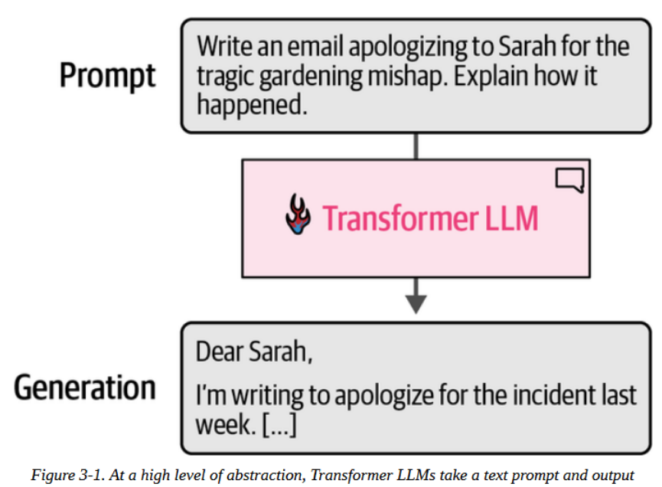
An Overview of Transformer Models
Transformer
The common understanding of a Transformer LLM is that it is a software system that takes in text and generates text in response.

Slide 3
An Overview of Transformer Models
Transformer
Once a large enough text-in-text model is trained on a large enough high-quality dataset, it becomes to able to generate impressive and useful outputs

Slide 4
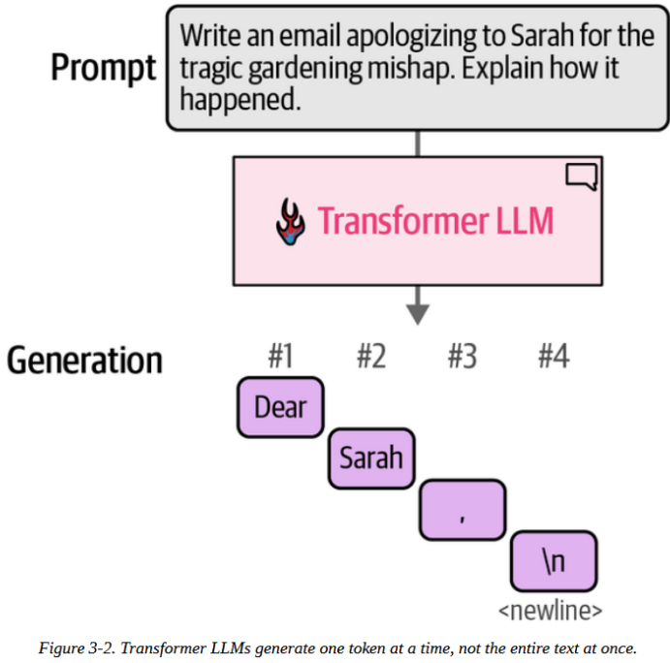
An Overview of Transformer Models
In contrast to what it may look like and how it is illustrated above, an LLM generates one output at a time (not in batches)

Slide 5
An Overview of Transformer Models
We know that a decoder-only transformer is autoregressive, meaning it takes the input prompt and append the previous output. This is illustrated in the image.
BERT and BERT-like (encoder-only) models, on the other hand, are not autoregressive.

Slide 6
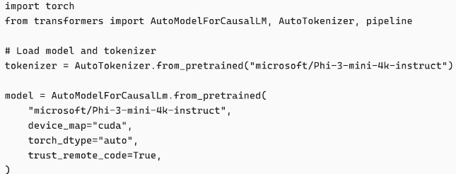
An Overview of Transformer Models
Let's see this work in real time:

Slide 7
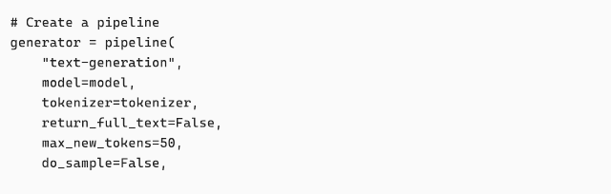
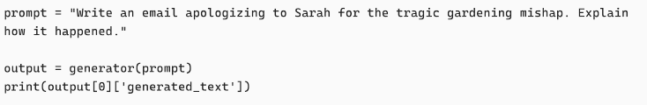
An Overview of Transformer Models
Let's see this work in real time:

Slide 8
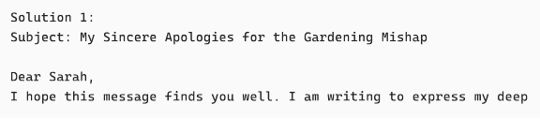
An Overview of Transformer Models
This generates the text:
You can see that the message is cut in the middle.
max_new_tokens = 50

Slide 9
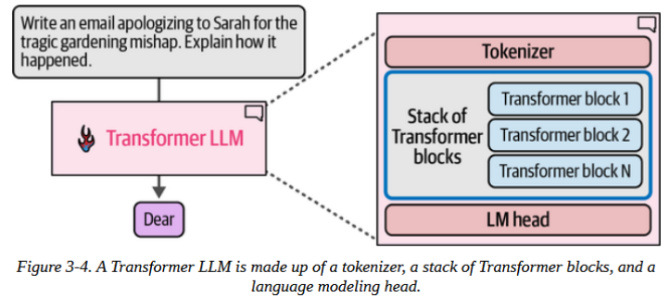
An Overview of Transformer Models

Slide 10
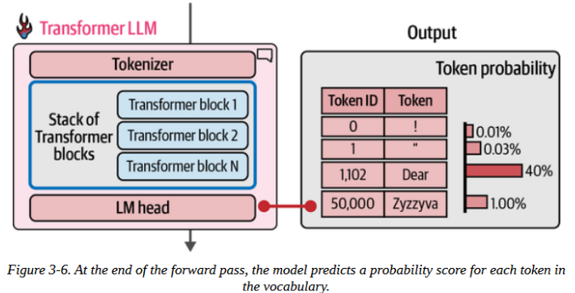
An Overview of Transformer Models
The flow of the computation follows the direction of the arrow from top to bottom

Slide 11
An Overview of Transformer Models
Each token flows once through each of the Transformer blocks in order
Then to the LM head, which outputs the probability distribution for the next token

Slide 12
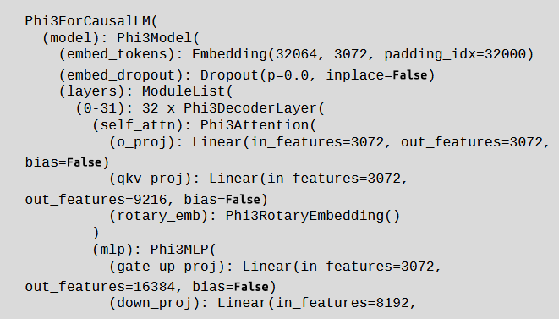
An Overview of Transformer Models
You can see the order of the layers by printing the `model` variable:

Slide 13
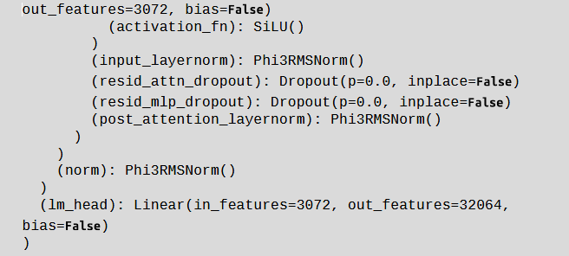
An Overview of Transformer Models
Continuation:

Slide 14
An Overview of Transformer Models
Checking the structure, we see:
The various nested layers of the model
Inside Phi3Model, we see `embed_tokens` (embedding matrix), and its dimensions - 32,064 tokens each, with a vector size of 3,072
The next layer (after dropout) is the stack of Transformer decoder layers - containing 32 blocks of type `Phi3DecoderLayer`

Slide 15
Choosing a Single Token from the Probability
Distribution (Sampling/Decoding)
The output of each forward pass is a probability score for every token in the library.
Decoding strategy: choosing a single token from the probability distribution
While choosing the one with the highest probability (greedy decoding) seems to be the most intuitive step, it doesn't always give the best outputs for many use cases. (e.g., creative writing where greedy decoding produces generic sentence)

Slide 16
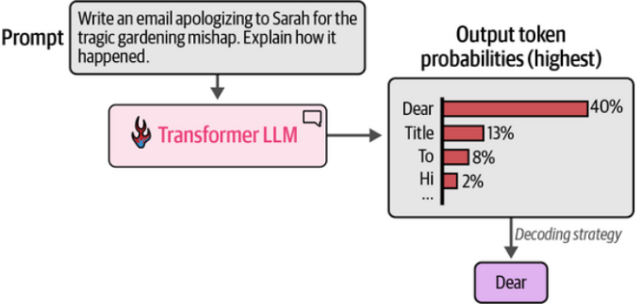
Choosing a Single Token from the Probability
Distribution (Sampling/Decoding)

Slide 17
Choosing a Single Token from the Probability
Distribution (Sampling/Decoding)
Choosing the highest scoring token every time is called greedy decoding.
This is what happens when temperature is set to 0
What is temperature?
It dictates the randomness of picking the token for the next word generation.
A high temperature means there is more randomness and it takes into account lower probability tokens from the distribution, while temperature close to 0 means the highest probability tokens will be picked

Slide 18
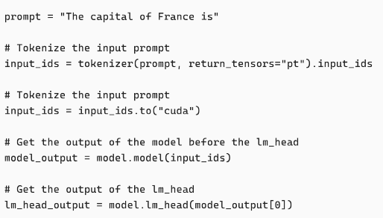
Choosing a Single Token from the Probability
In the following code, we pass the input tokens through the model, and then to `lm_head`:

Slide 19


Choosing a Single Token from the Probability
We can see that the model and its tokenizer has a vocabulary size of 32,064
Now the `lm_head_otput` is of the shape [1, 6, 32064].
We can decode the highest scoring probability token with
This prints out:

Slide 20
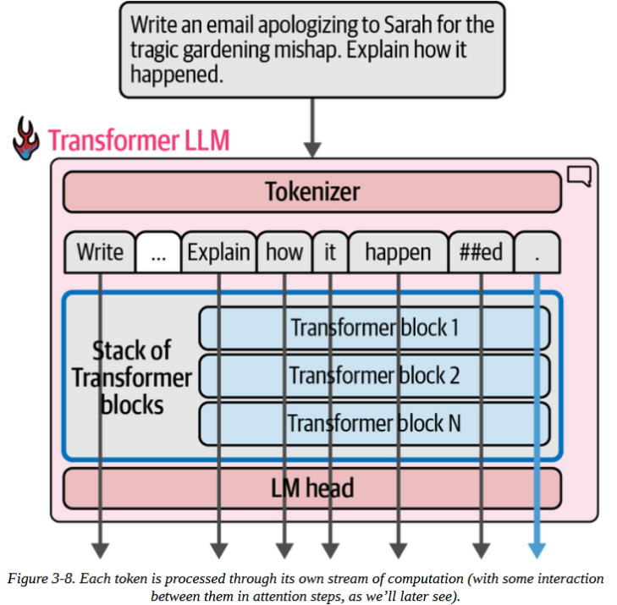
Parallel Token Processing and Context Size
Compared to previous neural networks, transformers handle parallel computing better.

Slide 21
Parallel Token Processing and Context Size
Current Transformer models have a limit for how many tokens they can process at once – context length
A model with 4K context length can only process 4K tokens and would only have 4K of these streams

Slide 22
Parallel Token Processing and Context Size
Current Transformer models have a limit for how many tokens they can process at once – context length
A model with 4K context length can only process 4K tokens and would only have 4K of these streams

Slide 23
Parallel Token Processing and Context Size
When processing "Write an email... Explain how it happened."...
the model tokenizes it into [Write, ...,Explain, how, it, happen, ##ed, .]
The model processes all 8 tokens all at the same time through the transformer blocks
Each token gets its own "stream" of computation, producing 8 output vectors

Slide 24
Parallel Token Processing and Context Size
For generation:
We only use the last position's output (the "." token at position 8) to predict what comes next (likely "Dear" or "Subject").
Why compute all 8 positions if we only use the last?
attention looks back at ALL previous positions' representations
it needs to know this is an email about a gardening mishap to predict next words.

Slide 25
Parallel Token Processing and Context Size
The output:
LM head produces: [8 × vocab_size] matrix (probabilities for all positions)
For generation: only position 8's probabilities matter → sample "Dear"
Next forward pass: append "Dear", run all 9 tokens through, use position 9 to predict token 10
This single forward pass produces ONE next token

Slide 26




Parallel Token Processing and Context Size
You can access these matrices and view their dimensions by running:
This outputs:
Similarly, we can print the output of the LM head:
This outputs:

Slide 27
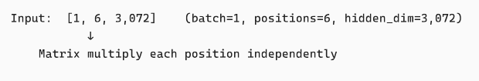
Parallel Token Processing and Context Size
For clarity:

Slide 28
Speeding Up Generation by Caching Keys and Values
Caching:
This is an optimization called keys and values (kv) cache and it significantly speeds up the generation process.
If the model could cache the results of the previous calculation, there would be no longer a need to repeat the calculations of the previous streams.

Slide 29
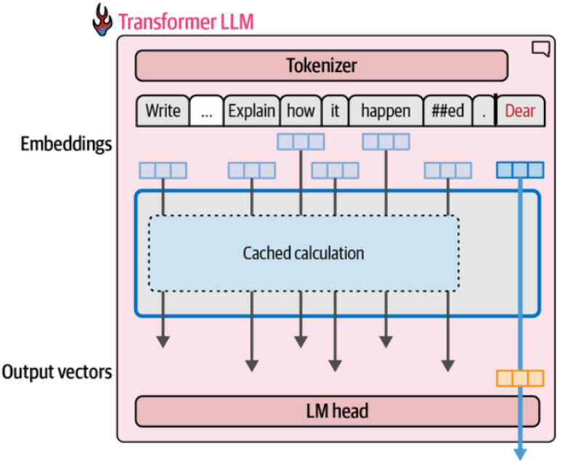
Speeding Up Generation by Caching Keys and Values
Caching:
In Hugging Face Transformers, cache is enabled by default, but can be disabled by setting use_cache to False .

Slide 30
Speeding Up Generation by Caching Keys and Values
• Autoregressive models append each generated token to input for next step
• Without caching, recompute Key/Value matrices for entire sequence every token
• With caching, store K,V vectors from previous tokens, only compute for newest
• Result: Dramatic speedup - reuse cached computations instead of recalculating (at every transformer block)

Slide 31
Speeding Up Generation by Caching Keys and Values
• Autoregressive models append each generated token to input for next step
• Without caching, recompute Key/Value matrices for entire sequence every token
• With caching, store K,V vectors from previous tokens, only compute for newest
• Result: Dramatic speedup - reuse cached computations instead of recalculating (at every transformer block)

Slide 32
Blocks = Layers: Where Does KV Caching Happen?
• Block = Layer = Transformer Layer (same thing, different names)
• Each block has multiple attention heads sharing one set of K,V matrices
• One KV cache per block - saves K,V vectors as tokens are generated
• Cache grows with generation: "The" → "The cat" → "The cat sat" (accumulating)
• Speedup: Generating token #20 doesn't recompute K,V for tokens #1-19

Slide 33
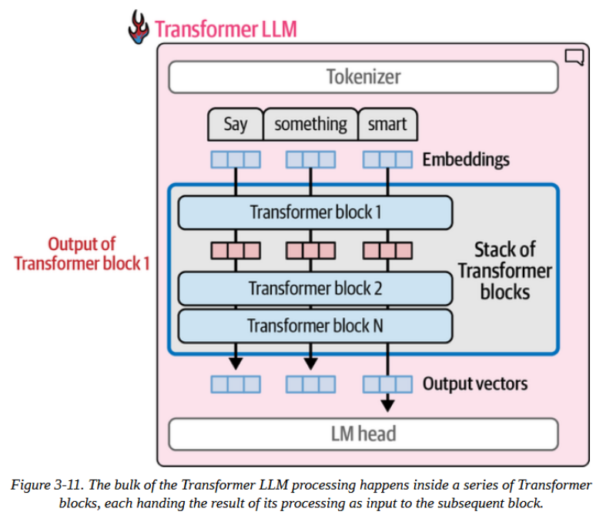
Inside the Transformer
Transformer LLMs are composed of Transformer blocks (6 in the original, > 100 in many large LLMs).

Slide 34
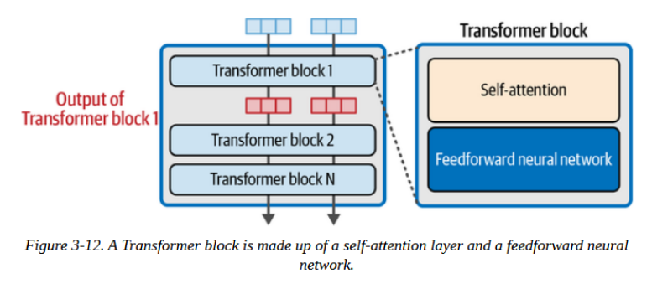
Inside the Transformer
2 components of the Transformer block:
The attention layer is concerned with incorporating relevant information from input tokens and positions
The feedforward layer has the majority of the model's processing

Slide 35
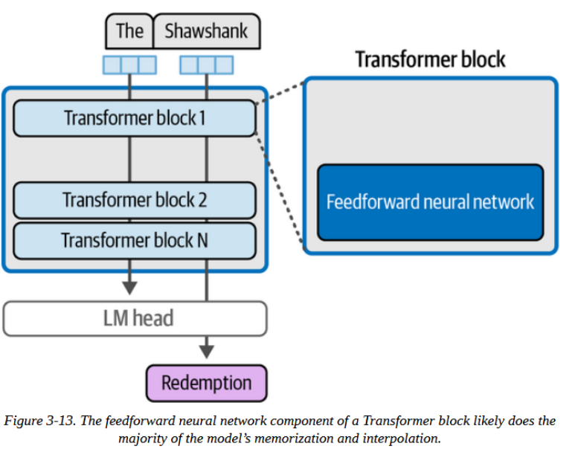
Inside the Transformer
The feedforward layer at a glance:
During training on large text datasets the FFN learned and stored associations.
The FFN handles this memorization of specific information and the interpolation between data allowing the model to handle new information.

Slide 36
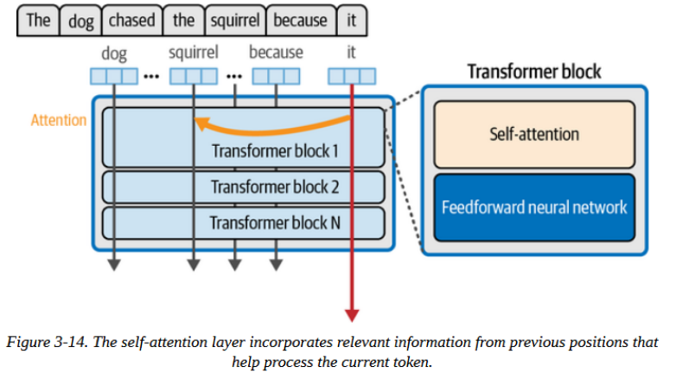
Inside the Transformer
The attention layer at a glance:
Attention helps the model incorporate the context
The model does that based on the patterns from the training data.

Slide 37
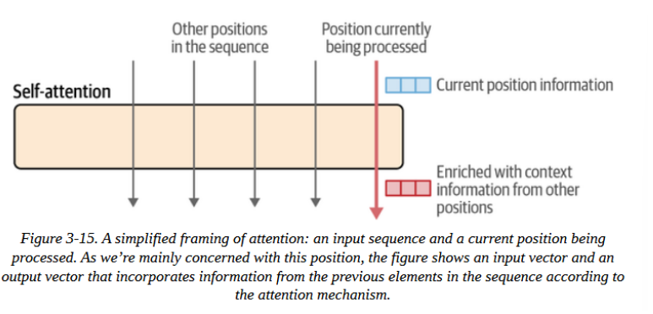
Inside the Transformer
Attention is all you need:

Slide 38
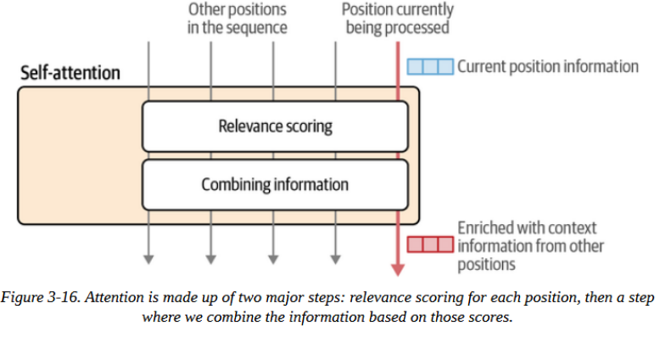
Inside the Transformer
2 main steps are involved in the attention mechanism:
A way to score the relevance of each of the previous input tokens are to the current token (in the pink arrow)
Using those scores, we combine the information from the various positions into a single output vector.

Slide 39
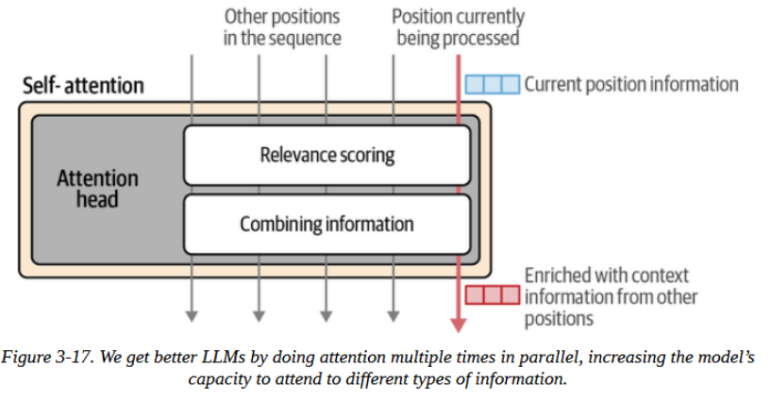
Inside the Transformer
To improve the Transformer's attention, the model runs multiple attention mechanisms in parallel, called an attention head.
Each attention head learns different information from the input.

Slide 40
Inside the Transformer
To understand how attention is calculated:
The attention layer is processing attention for a single position - the next token
The inputs to the attention layer are:
the vector representation of the current position/token
the vector representations of the previous tokens
The goal is to produce a new representation of the current position (the word to be predicted) that incorporates relevant information from the previous tokens

Slide 41
Inside the Transformer
To understand how attention is calculated (continuation):
The training process produces three projection matrices:
A query (Q) projection matrix
A key (K) projection matrix
A value (V) projection matrix

Slide 42
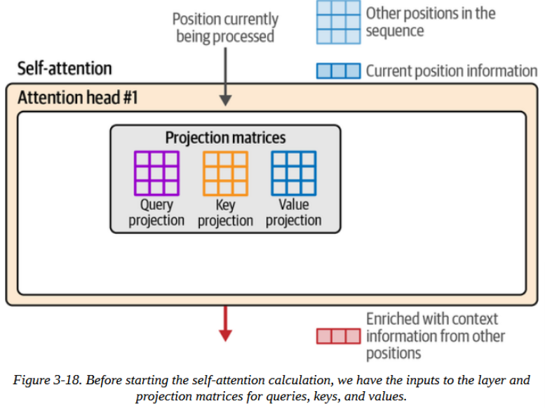
Inside the Transformer
Attention starts by multiplying the inputs by the projection matrices to create three new matrices.

Slide 43
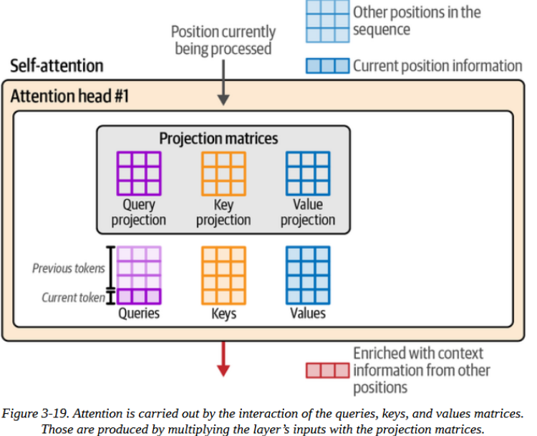
Inside the Transformer
The 3 resulting matrices (K, Q, V) help carry out 2 steps of attention:
Relevance Scoring
Combining Information

Slide 44
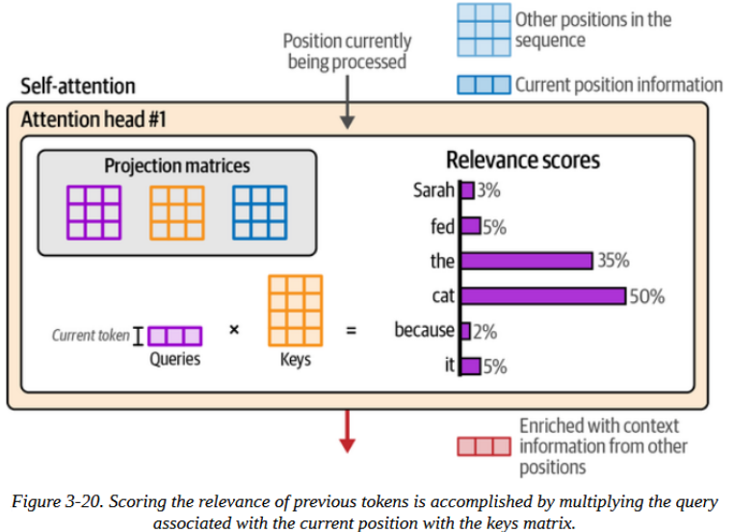
Inside the Transformer
Relevance Scoring
Conducted by multiplying the query vector of the current position with the keys (K) matrix
The query matrix is a stack of multiple query vectors from previous positions and the current position

Slide 45
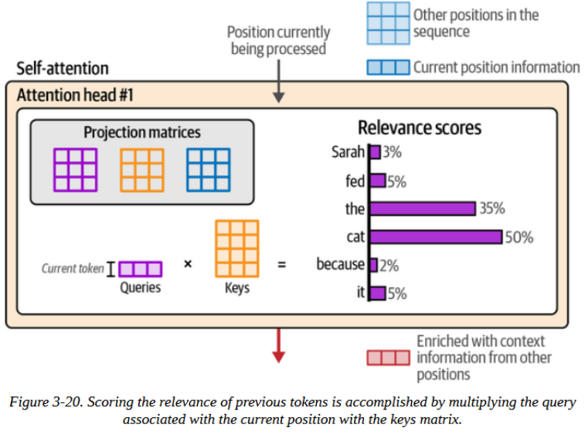
Inside the Transformer
Relevance Scoring
Cmatrix
The query matrix is a stack of multiple query vectors from previous positions and the current position

Slide 46
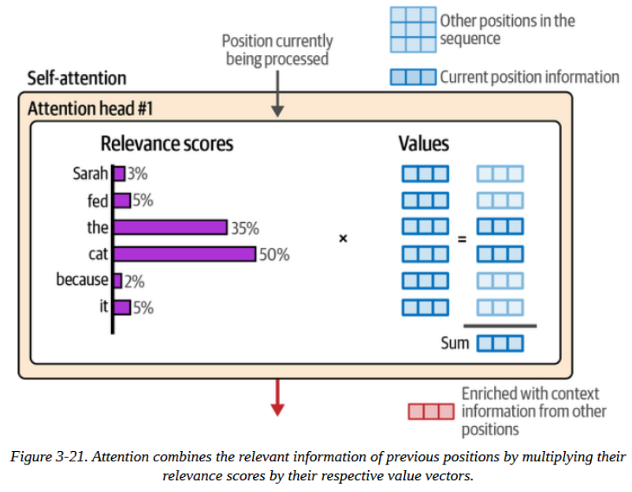
Inside the Transformer
Combining Information
After obtaining the relevance scores from the last step, we multiply the value (V) vector associated with each token by that token's score
The resulting vectors are summed, to be the result of this step

Slide 47
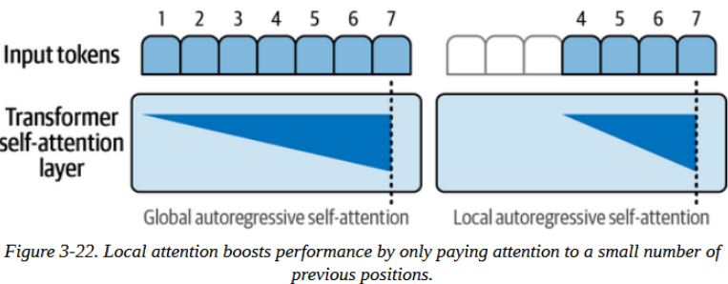
Recent Improvements
Local/sparse attention
Limits attention to recent tokens instead of all previous tokens for efficiency
Reduces computational cost but risks losing important context
Trade-off: faster processing vs potentially degraded generation quality

Slide 48
Recent Improvements
GPT-3's Hybrid Attention Strategy
Alternates between full-attention blocks (see all tokens) and sparse-attention blocks (limited window)
Block 1 and 3 use full attention for context, Block 2 and 4 use sparse for efficiency

Slide 49
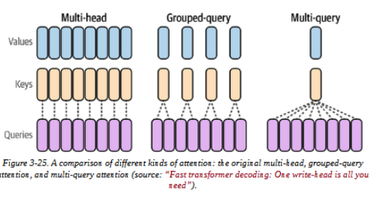
Recent Improvements
Multi-head Attention (Original)
Each attention head has its own separate Q, K, V projection matrices
16 heads = 16 different sets of matrices = rich diverse patterns
High memory cost but maximum flexibility for heads to specialize

Slide 50
Recent Improvements
Multi-query Attention
All heads share the same K and V matrices, only Q remains unique per head
Memory reduction: 1 set of K,V instead of 16 sets
Faster inference but potentially lower model quality from less specialization

Slide 51
Recent Improvements
Grouped-query Attention (Balance)
Heads divided into groups that share K,V matrices within each group
Example: 16 heads split into 4 groups of 4 heads sharing matrices
Sweet spot between efficiency of multi-query and quality of multi-head

Slide 52
Recent Improvements
Flash Attention
Optimizes data movement between GPU's fast SRAM and slower HBM memory
Doesn't change attention math, just improves memory access patterns
Significant speedup for both training and inference

Slide 53
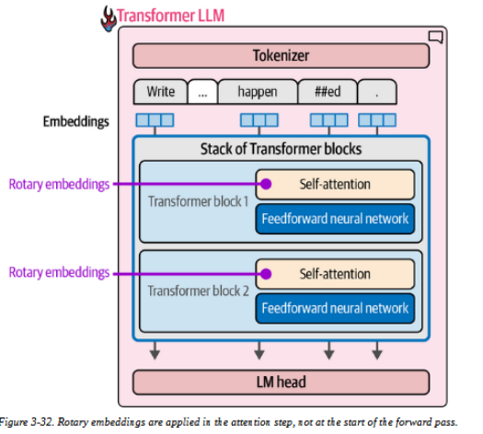
Recent Improvements
Rotary Positional Embeddings (RoPE)
Encodes position during attention computation rather than at input
Rotates vectors in embedding space based on position, applied to Q and K matrices
Captures both absolute and relative position while naturally handling document packing

Slide 54
END

